Slide 1
Telecom Systems Laboratory TLEN 5460 NAT/PAT, Redistribution and Access Lists
Jose Santos
Interdisciplinary Telecommunications Program

Slide 2
IP Address Depletion
Class rules and internet boom were consuming IP address space (by mid-90’s would be depleted)
126 Class A networks up to 16,777,214 hosts each
Plus 65,000 Class B networks up to 65,534 hosts each
Plus over 2 million Class C networks up to 254 hosts each
VLSM
Variable Length Subnet Mask

Slide 3
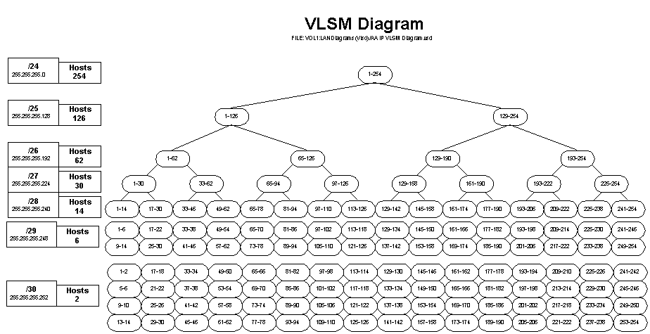
IP Address Depletion
Source: http://www.more.net/technical/netserv/tcpip/IP-VLSM-Diagram.html

Slide 4
Optimizing the usage of IP addresses
CIDR
Classless Inter Domain Routing (RFC 1817)
CIDR also allows the allocation of subsets of network addresses to a specific customer preventing waste of IP addresses
IP address aggregation generates smaller routing tables
To work ISP must have control of consecutive network numbers

Slide 5
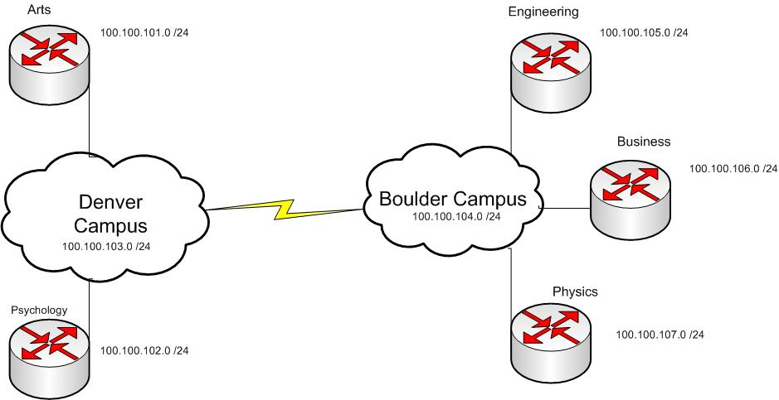
Network Diagram w/o CIDR
Any class any mask, mask should be same across all network

Slide 6
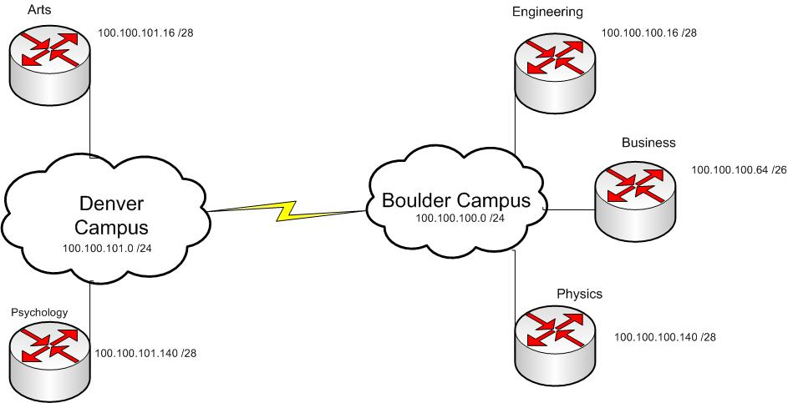
Optimizing the usage of IP addresses

Slide 7
Private Address Space
Isolated Networks
Can use any IP address they please
Non-registered Network Numbers (private internets)
10.0.0.0 -> 10.255.255.255 (1 network)
172.16.0.0 -> 172.31.255.255 (16 networks)
192.168.0.0 -> 192.168.255.255 (256 networks)
No organization is allowed to advertise these networks using routing protocols on the Internet

Slide 8
Public IP Space
Registry Geographic Region
AfriNIC Africa, portions of the Indian Ocean
APNIC Portions of Asia, portions of Oceania
ARIN Canada, United States, islands in the Caribbean Sea and North Atlantic Ocean
LACNIC Latin America, portions of the Caribbean
RIPE NCC Europe, the Middle East, Central Asia
Application Process
http://www.arin.net/education/isp_initial/index.html

Slide 9
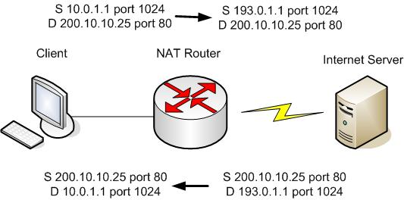
Network Address Translation
NAT allows networks with Private IP Address space to connect to the Internet
NAT “translates” a Private IP into a Public IP Address, while keeping a dynamic table of such translations

Slide 10
NAT Terminology
Inside local
Refers to an address used by a host “inside” an enterprise (usually a private address)
Inside Global
Registered address used to connect an internal host to the Internet (usually a public address)
Outside Global
Actual IP address of a host located in the Internet or outside the enterprise ( uses an address that can be routed in the Internet)
Outside local
When a company uses a private address (in the NAT router) to represent a host from the Internet (with public address). Used on overlapping addresses

Slide 11
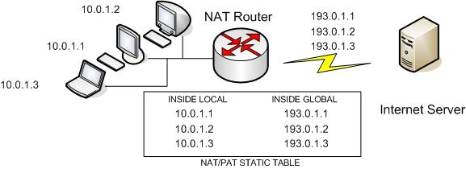
NAT Variations
Static NAT
NAT router simply configures a 1 to 1 mapping between the private address and the registered address
Converts and inside local to an inside global. Same values every time / same mapping
Not efficient as x internal hosts need Internet connectivity x mappings to public IPs must be performed on the router

Slide 12
NAT Variations
Dynamic NAT
Same 1 to 1 mapping
Inside global addresses are assigned dynamically. First come, first served
Sets up a pool of inside global addresses and defines the rules of which inside local addresses must be translated. As a packets enters the NAT router and matches the logic, router adds an entry in the NAT table, this entry stays in the table as long as traffic flows occasionally (timeout value)
Inside local group may be greater than inside global, however if global pool is fully allocated and a new packet arrived it will be discarded.
Global pool must be as large as max number of hosts that need to use the Internet at the same time

Slide 13
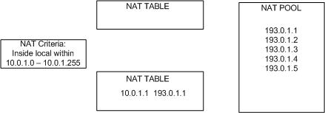
Dynamic NAT

Slide 14
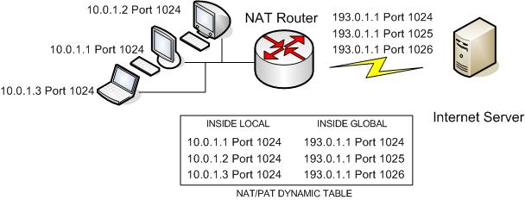
Overloading NAT (PAT)
PAT (Port Address translation)
Additional feature of NAT
Permits multiple connections using a single IP address
Translates both IP and port numbers (Socket)
NAT/PAT router keeps a table entry for each IP/Port combination
Up to 64000 connections with a single IP

Slide 15
Overlapping addresses
Situation created when an isolated network uses registered IP addresses for its internal local and later connects to the Internet.
Inside local range 66.94.230.0 /24
www.yahoo.com is 66.94.230.39 /24
Problem: How to distinguish between inside local and inside global
Solution: NAT can translate both source and destination IP addresses
NAT configuration includes a static mapping between real IP address (outside global) and the private IP address (outside local) used to represent it inside a private network
NAT router must also change the DNS responses for requests initiated by hosts from inside local
Best solution: next time use private addresses instead

Slide 16
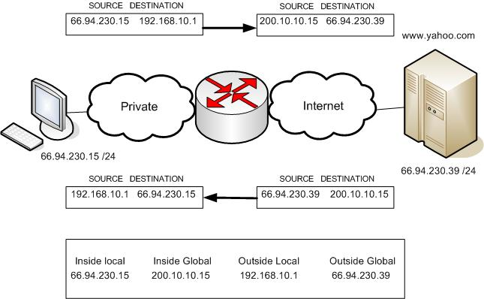
Overlapping
NAT TABLE

Slide 17
IP Address depletion
IPv6
Proposed new version of IP protocol
Has a larger address structure
128 bits written in hex / 16 octets
10.10.10.10
0000.0000.0000.0000.FFFF.FFFF.0A0A.0A0A
0000 1010. 0000 1010. 0000 1010. 0000 1010
Available addresses 2^128 = 3.4 *10^38
340000000000000000000000000000000000000.
“a 128-bit address space provides 655,570,793,348,866,943,898,599 (6.5 × 1023) addresses for every square meter of the Earth's surface.”

Slide 18
Redistribution
More than 1 routing protocol within an organization
Some static routing and some dynamic Routing
Transition from one routing protocol to another
Organizational, Merge, Takeover.
Equipment Dependencies, Legacy support.
Ideological differences between Network Administrators
Redistribution:
Pass information learned from one protocol to another
Manual (Static Routes, All Routing Protocols)
Automatic (EIGRP and IGRP if AS numbers match)

Slide 19
Redistribution
Considerations
Routing Metrics
hops/link speeds/delay
default values per protocol
Path Selection Between Routing Protocols
administrative distance
external vs. internal Routes
Loop prevention
Security
Level of trust
static routes, default routes, passive interfaces, distribute lists, route maps

Slide 20
Access Lists
Filter based on criteria
Recall L2 MAC address filtering
Trunking VLAN propagation

Slide 21
Access Lists
Applications
Make a router discard packets based on defined criteria
Prevent unwanted traffic on the network
Prevent hackers from penetrating the network
Prevent employees from accessing network resources
Can also be used to filter routing updates
To match packets for prioritization , VPN tunneling
Types of Access Lists
Standard (S-IP)
Extended (S-IP, D-IP, Sport & DPort)
Named

Slide 22
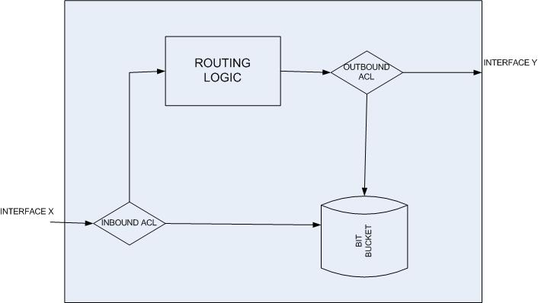
Internal Processing of ACLs

Slide 23
Features of ACL’s
Packets can be filtered as they enter the interface before routing decision
Packets can be filtered before they exit the interface, after the routing decision
Filtering logic is configured in the access list
IOS terminology:
Deny: packet will be filtered
Permit: packet will not be filtered

Slide 24
Features of ACL’s
Cisco IOS searches the ACL sequentially, until the FIRST statement match
First match stops the search and an action is taken
“Implicit Deny”
Any packet that does not match any entry on the ACL will be discarded
Steps to implement an ACL
Determine location of ACL
Create the “ACL”
Apply it on an interface ( either for inbound or outbound traffic)

Slide 25
Matching IP Information
Wildcard masks
Define the portion of the IP address that should be examined
Recall OSPF masks ( on network statement )
0 bits: Do care
1 bits: Don’t care
0.0.0.0 Match whole IP address
0.0.0.255 Match first 24 bits
0.0.255.255 Match first 16 bits
0.255.255.255 Match first 8bits
255.255.255.255 Don’t bother comparing, any value will match
0.0.15.255 Match the first 20 bits
0.0.3.255 Match the first 22 bits

Slide 26
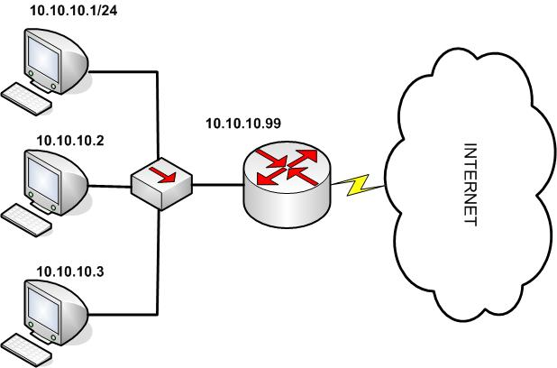
Standard ACLs
Can only filter on basis of Source IP
Use numbers in the range of 1-99 and 1300-1999

Slide 27
Standard ACLs
access-list acl_number action ip_address/subnet
interface Ethernet 0
ip address 10.10.10.4 255.255.255.0
ip access-group 1 in
access-list 1 remark don’t let .1 visit the web
access-list 1 deny 10.10.10.1 0.0.0.0
access-list 1 permit 0.0.0.0 255.255.255.255 (all IP source addresses)
access-list 1 deny host 10.10.10.1
access-list 1 permit any
show ip interface ( ACL’s enabled on a specific interface )
show access-lists ( ACL’s for all protocols )
show ip access-list ( ACL’s for IP )

Slide 28
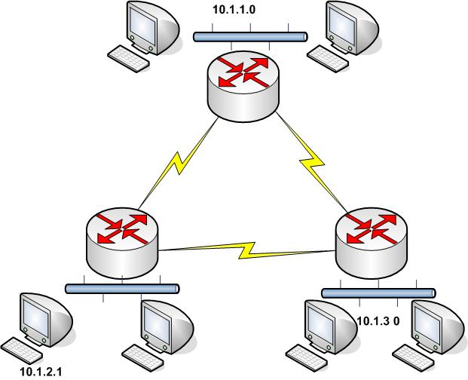
Standard ACLs

Slide 29
Standard ACLs
10.1.2.1 not allowed to visit 10.1.1.0 /24
interface ???????
ip access-group 2 ???
access-list 2 deny host 10.1.2.1
access-list 2 permit any
access-list 2 deny 10.1.2.1 0.0.0.0
access-list 2 permit 0.0.0.0 255.255.255.255

Slide 30
Standard ACLs
Hosts on subnet 10.1.3.0 /24 not allowed to visit subnet 10.1.2.0 /24
interface ???????
ip access-group 2 ???
access-list 3 deny 10.1.3.0 0.0.0.255
access-list 3 permit any
Remember: Consider link failures, route re-convergence, blocking more than necessary

Slide 31
Extended ACLs
Can filter on basis of Source IP, destination IP, Source Port & Destination Port and others

Slide 32
Extended ACLs
EACLs are enabled on a specific interface for both inbound and outbound traffic
IOS searches for a match statement sequentially
First match stops the search and an action is taken
Implicit Deny rule is still applicable
ACL numbering ranges 100-199 and 200-2699

Slide 33
Extended ACLs
Extended Access Lists commands
access-list acl_number action source (IP/SPort) destination (IP/DPort)
access-list 101 deny ip any host 10.1.1.1
access-list 101 deny tcp any gt 1023 host 10.1.1.1 eq 23
access-list 101 deny tcp any host 10.1.1.1 eq 23
access-list 101 deny tcp any host 10.1.1.1 eq telnet
access-list 101 deny udp 1.0.0.0 0.255.255.255 lt 1023 any

Slide 34
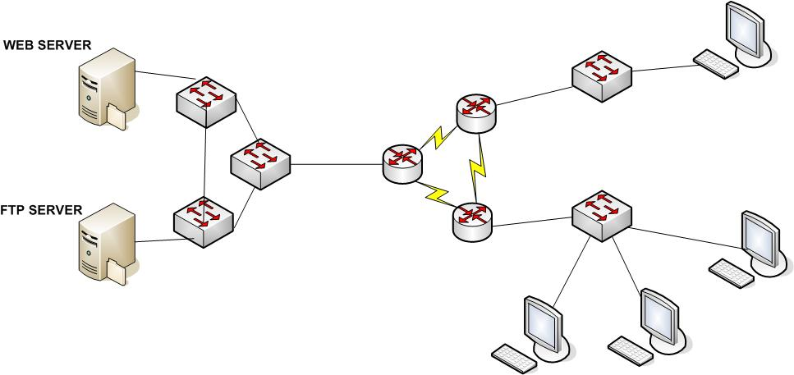
Extended ACLs
10.10.10.0/24
A
10.10.20.0/24
WEB SERVER 2
10.10.30.0 /24
B
D
C

Slide 35
Extended ACLs
Don’t permit station A (10.1) to ftp files to server (30.2)
Don’t permit station B (20.1) to visit our websites (30.1/30.2)
Which interface will you use? why?
access-list 101 deny tcp host 10.10.10.1 host 10.10.30.2 eq ftp
access-list 101 deny tcp host 10.10.10.2 10.10.30.0 0.0.0.255 eq http
access-list permit ip any any
access-list deny tcp host 10.10.10.2 10.10.30.0 0.0.0.255 eq ftp

Slide 36
Extended ACLs
Router A

Slide 37
Extended ACLs
10.1.2.1 not allowed to visit 10.1.1.0 /24
Hosts on subnet 10.1.3.0 /24 not allowed to visit subnet 10.1.2.0 /24
In router A
interface Ethernet 0
ip access-group 110 in
access-list 110 deny ip host 10.1.2.1 10.1.1.0 0.0.0.255
access-list 110 deny ip 10.1.2.0 0.0.0.255 10.1.3.0 0.0.0.255 **
access-list 110 permit ip any any
** NOTE: security by impairing communication back to network 10.1.3.0

Slide 38
ACL Implementation Considerations
Use text editor
Easy to correct errors
EACLs and SACLs cannot remove a single list entry, you can only remove the whole ACL.
Place Extended ACLs closer to source of IP packet
Discard the packets quickly
Place Standard ACLs closer to the destination
SACLs tend to filter more than necessary, avoid filtering traffic you don’t mean to filter.
Place more specific statement early on the ACL
Remember that first match on table, stops the search and takes action
Disable an ACL from an interface before making changes to it.
Remember: Implicit deny and that Interface permits all traffic if ACL not existent

